Slide 1
Unrolling algorithms for tomography of limited angles
Group component:
Kamal Nishantha Angunna Gamage
Matteo Fontana
Giuseppe Spathis
Supervisor:
Elena Loli Piccolomini

Slide 2
Project description
Objective: Reconstruct CT images from limited-angle sinograms using an unrolling method (Adler et al.) with a Residual U-Net architecture.
Comparison: Evaluate the unrolling Plug-and-Play algorithm against a Total Variation (TV) model-based reconstruction.
Dataset: Mayo Clinic CT Dataset Link

Slide 3
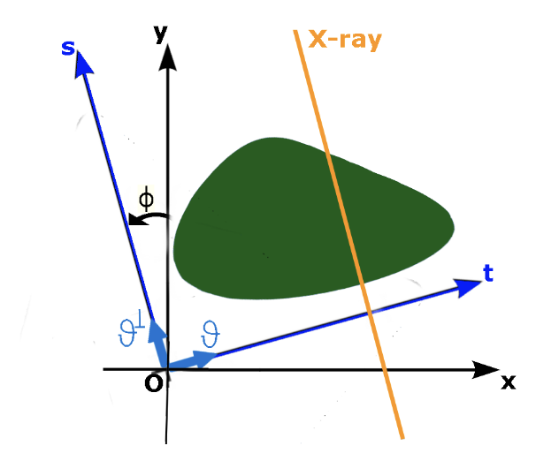
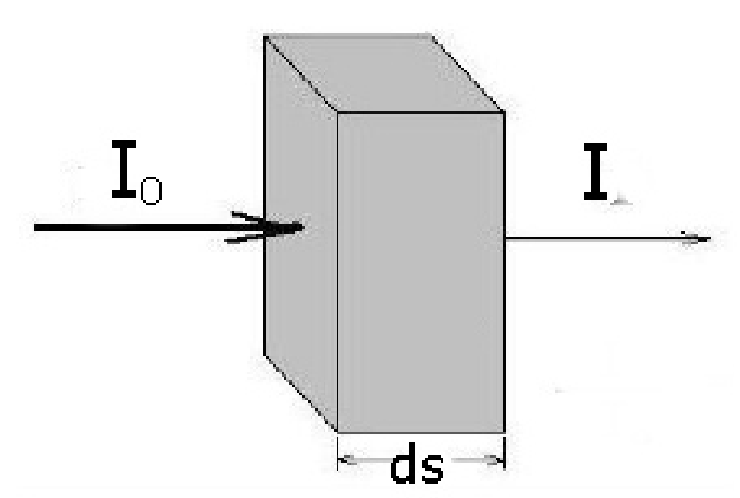
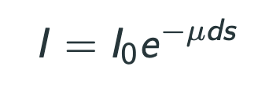
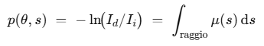
Theory Introduction

Slide 4
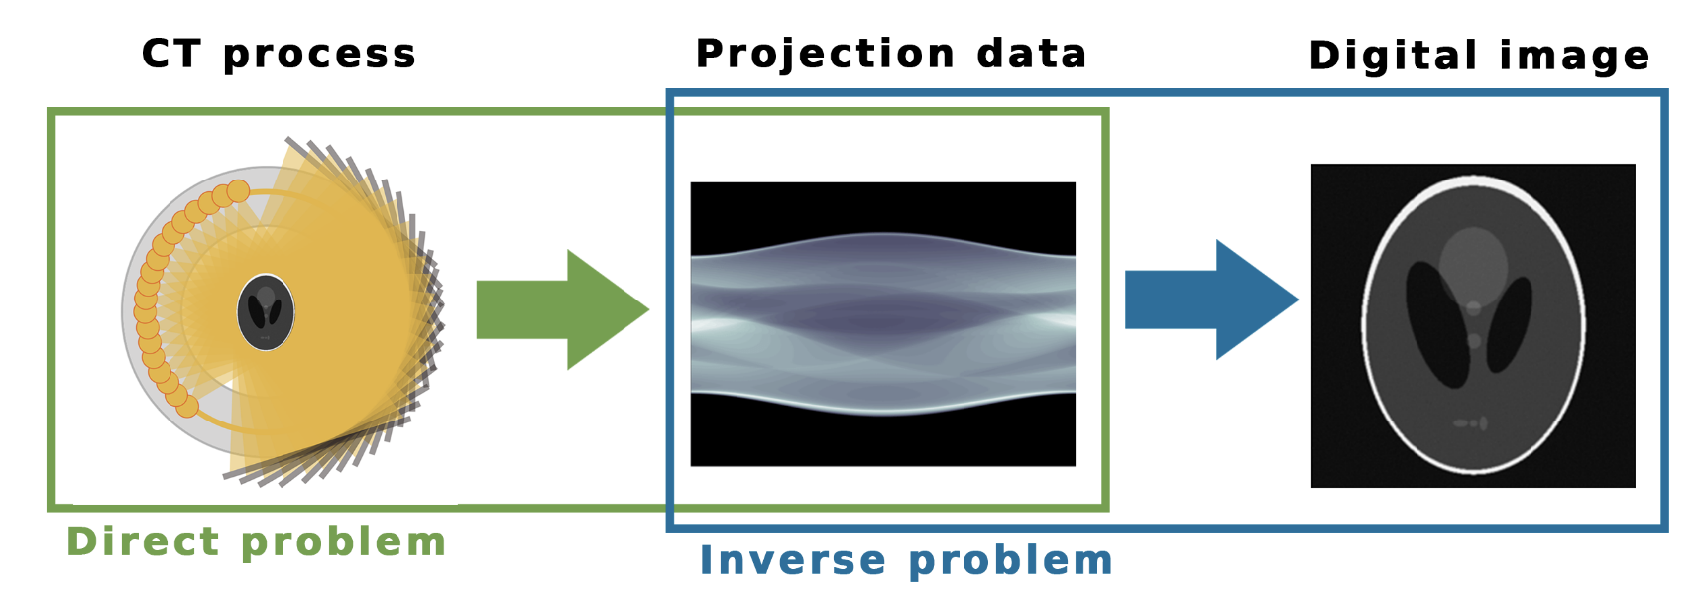
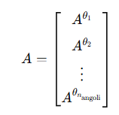
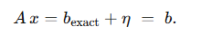
Problem description

Slide 5
Methodology
We have compared 3 algorithms:
Filtered Back Projection.
Total Variation regularization.
The unrolled method: Learned-Primal dual.

Slide 6
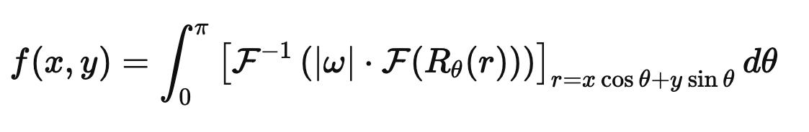
FBP - Theory
FBP (Filtered Back Projection) is a direct method for image reconstruction from sinograms (Radon projections).
Rθ​(r) is the Radon transform (i.e., projection at angle θ)
F and F−1 are the Fourier and inverse Fourier transforms
∣ω∣ is the ramp filter in the frequency domain (or other filters like Shepp–Logan, Hamming, etc.)
This formula:
Filters the sinogram in frequency domain (amplifying high-frequency components).
Back-projects the filtered projections over the image domain.
Fast and non-iterative, but sensitive to noise and artifacts.

Slide 7
FBP - Implementation
Function used: skimage.transform.iradon
Input: sinogram
Main parameters:
theta = np.linspace(0., 180., max(img.shape), endpoint=False)
filter_name = "ramp" (Ram-Lak filter)
Output: reconstructed image using inverse Radon transform.

Slide 8
FBP - Code

Slide 9
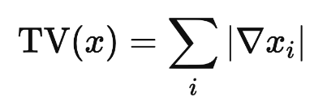
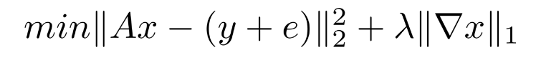
TV - Theory
Enhance image reconstruction by preserving edges while removing noise.
Total Variation is defined as the sum of gradient magnitudes:
Solves problems of the form:

Slide 10
TV - Implementation
Optimization Algorithm: ISTA (Iterative Shrinkage-Thresholding Algorithm)
Step Size (Learning Rate): step_size = 0.005
Regularization Weight: lambda_tv = 0.05 (tuned for balance between data fidelity and smoothness)
Proximal Operator: tv_proximal_operator(update, weight=lambda_tv * step_size) (uses Chambolle's method from skimage.restoration.denoise_tv_chambolle)
Number of Iterations: num_iterations = 100

Slide 11
TV - Code

Slide 12
LPD - Theory
Primal Space contains the reconstructed image
Dual space contains the sinogram
In our case, we use 10 unrolled iterations, and for each iteration we have two U-Nets:
- a primal U-Net, designed to denoise the image
- a dual U-Net, responsible for correcting the reconstruction to ensure fidelity to the sinogram.

Slide 13
LPD - Implementation
Hyperparameters:
- learning rate: 10^-3
- number of unrolled iteration: 10
- epochs: 20-30
Batch size: 4

Slide 14
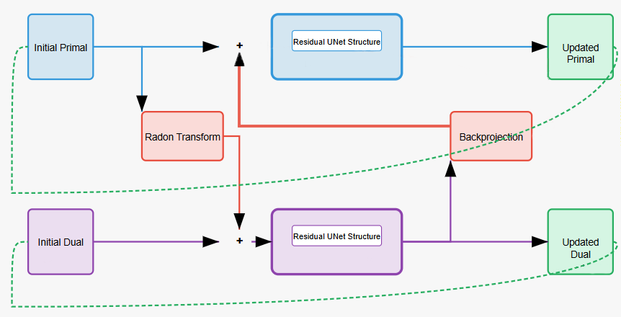
LPD DESIGN
Each U-Net consists of two layers, with 32 features in the first and 64 in the second, and includes residual blocks between them.
Total params: 7,555,860
Trainable params: 7,555,860
Non-trainable params: 0

Slide 15
Introducing the experiments
Test Geometries:
30 angles in [-30°, 30°]
30 angles in [-15°, 15°]
30 angles in [0°, 180°]
Each tested with and without noise (noise level = 0.1)
Metrics:
Relative Error (RE)
PSNR
SSIM
Outputs:
Reconstruction results for selected images, with zoom-in area visualizations
Average metrics across a subset of the test set, presented in a .xlsx file

Slide 16
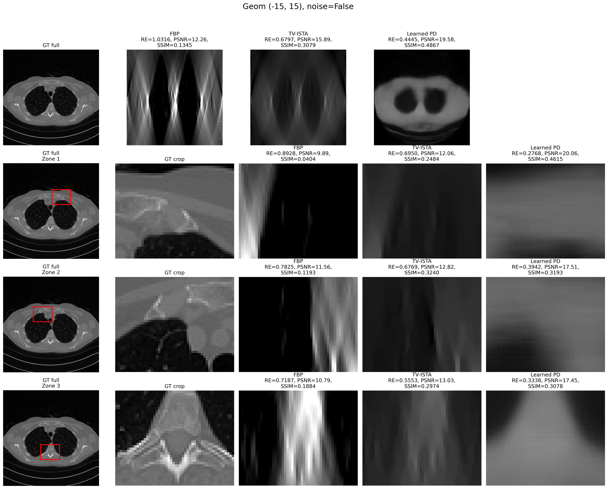










Geom (-15°, 15°)
Noise = False

Slide 17
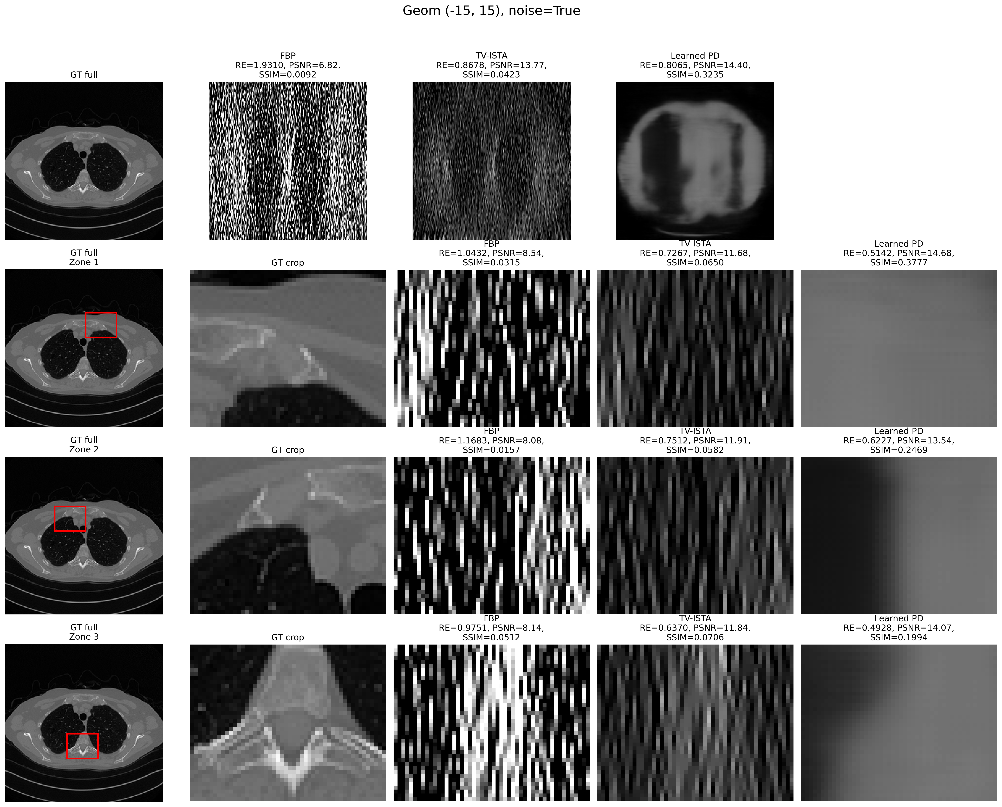











Geom (-15°, 15°)
Noise = True

Slide 18
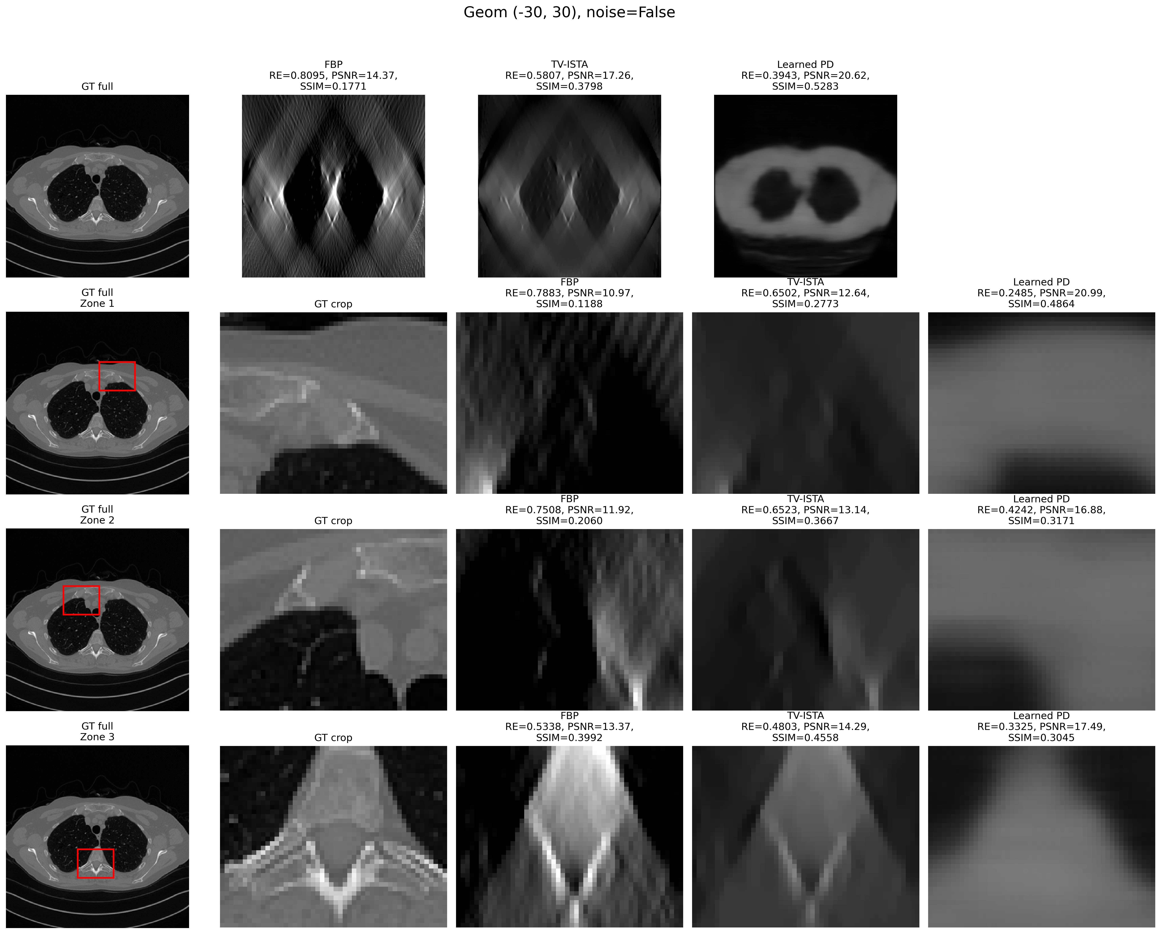












Geom (-30°, 30°)
Noise = False

Slide 19
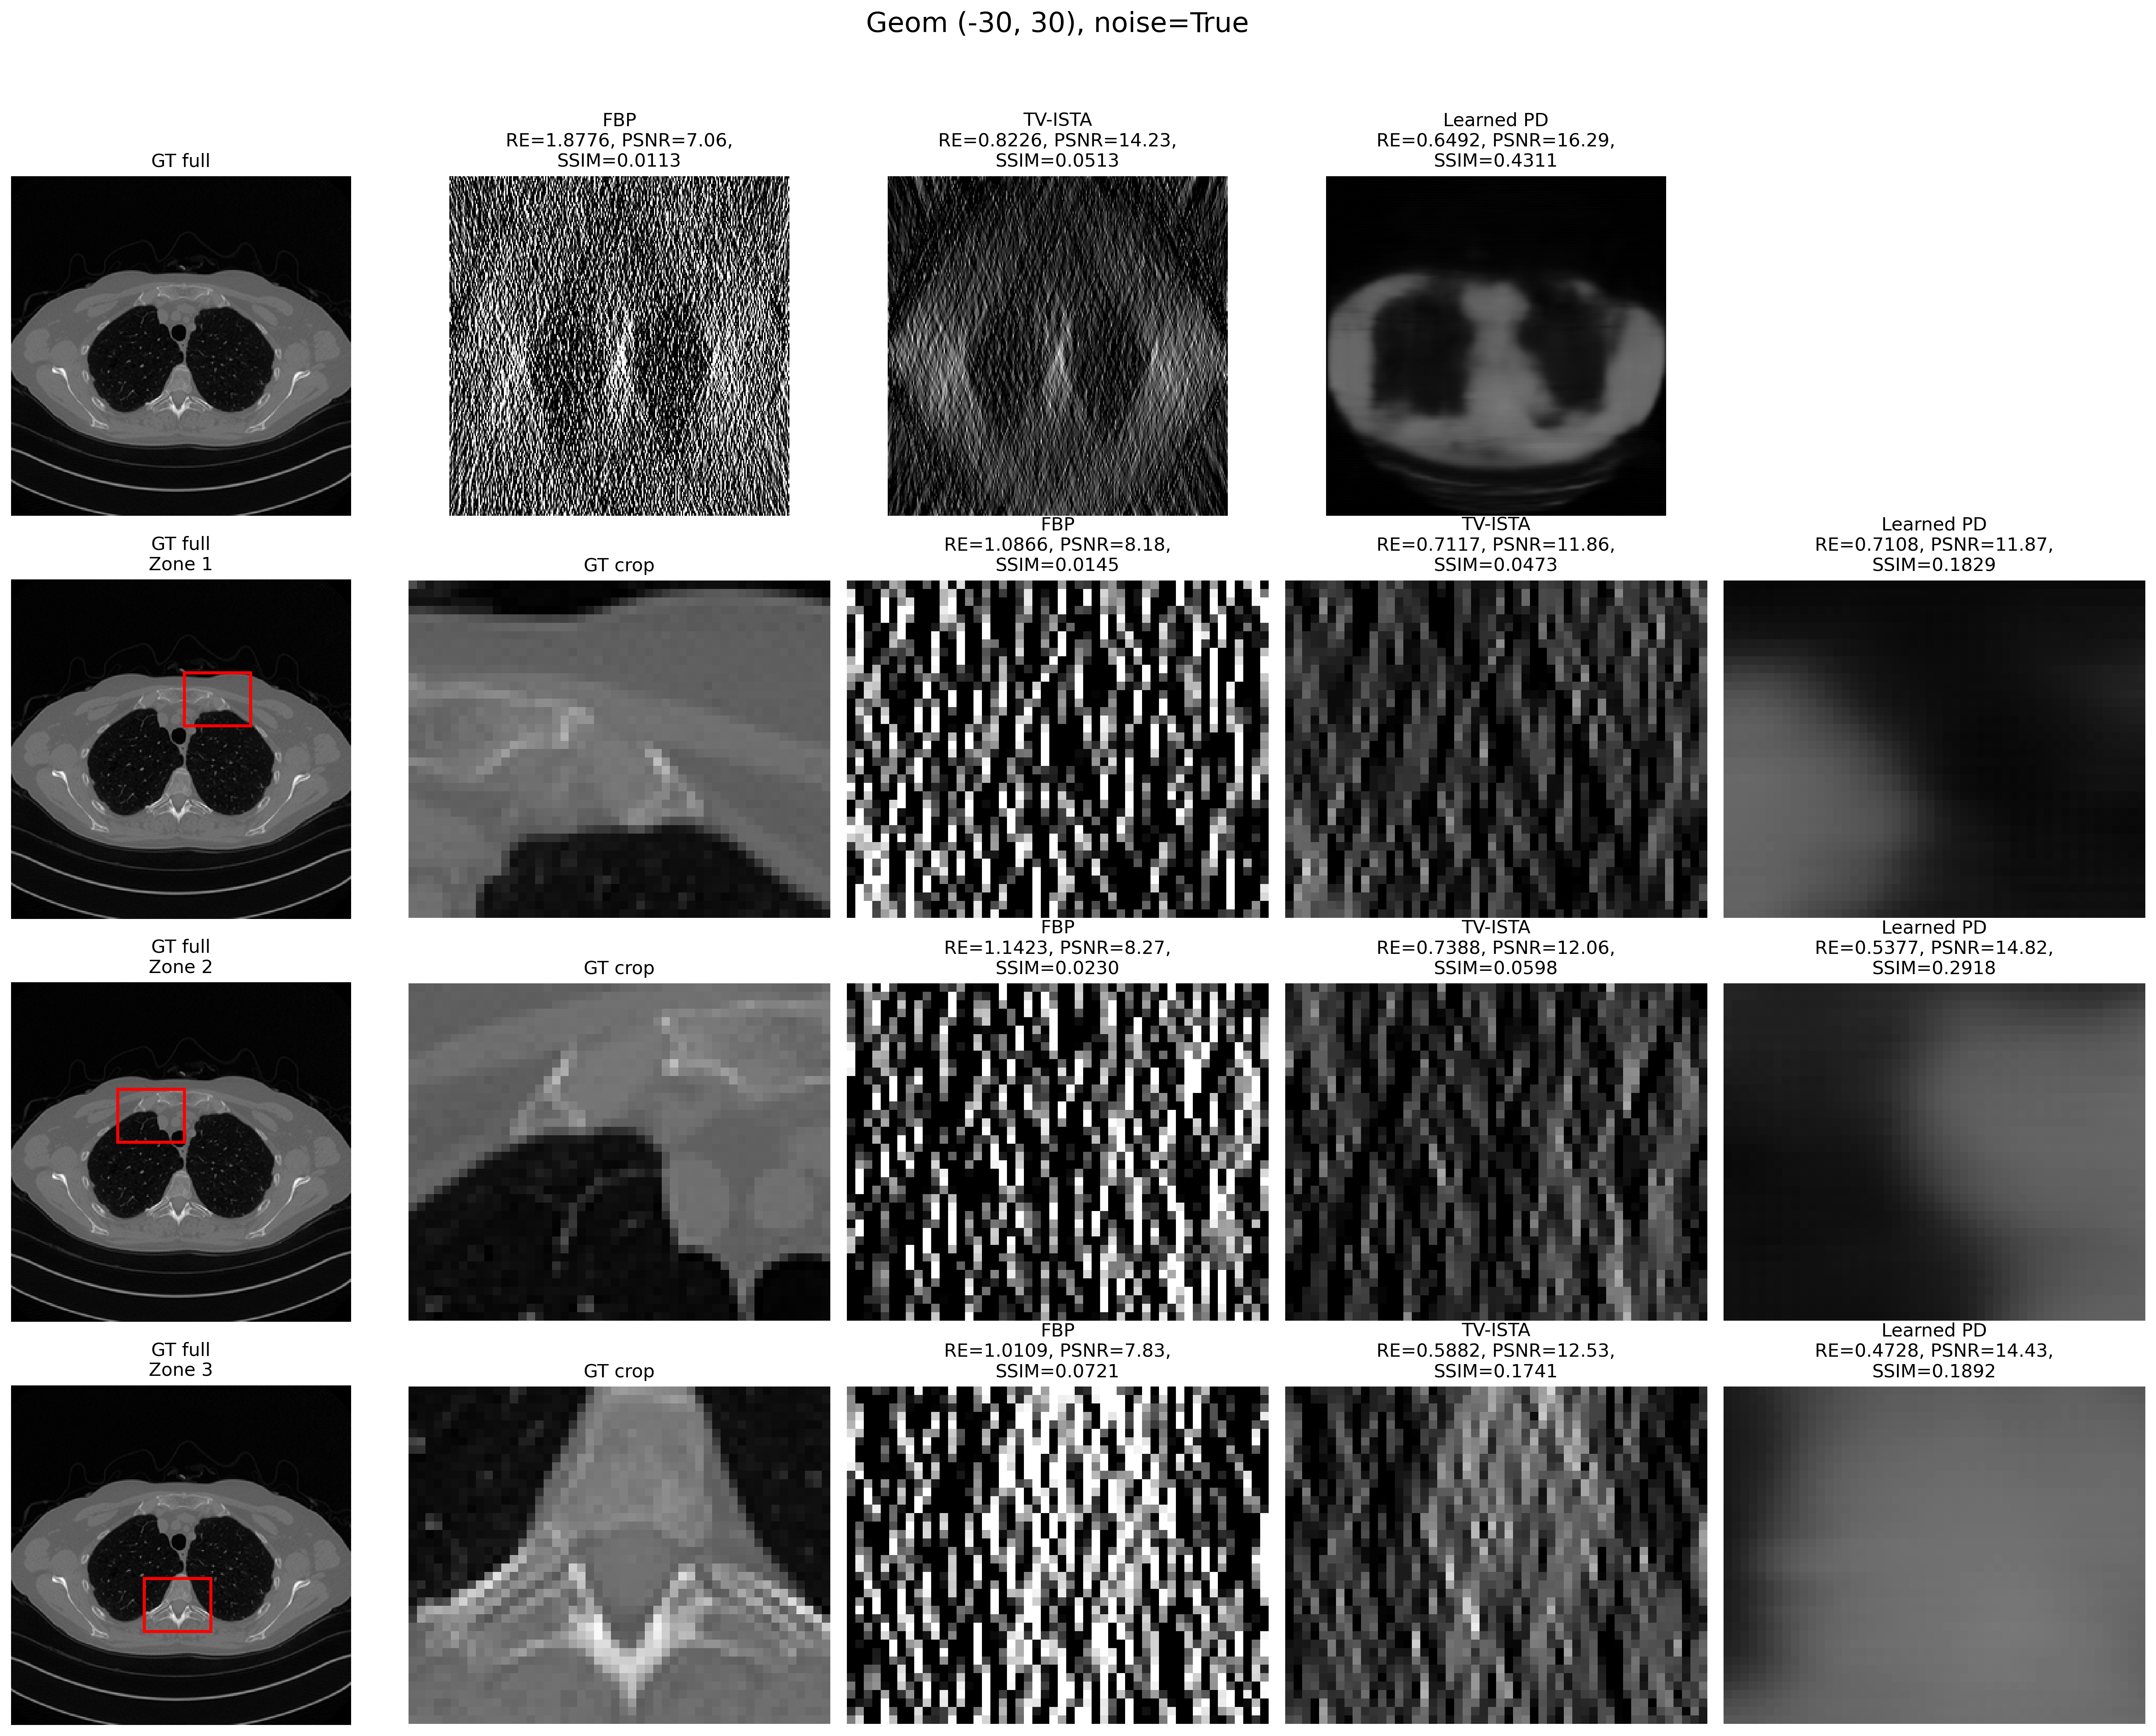











Geom (-30°, 30°)
Noise = True

Slide 20
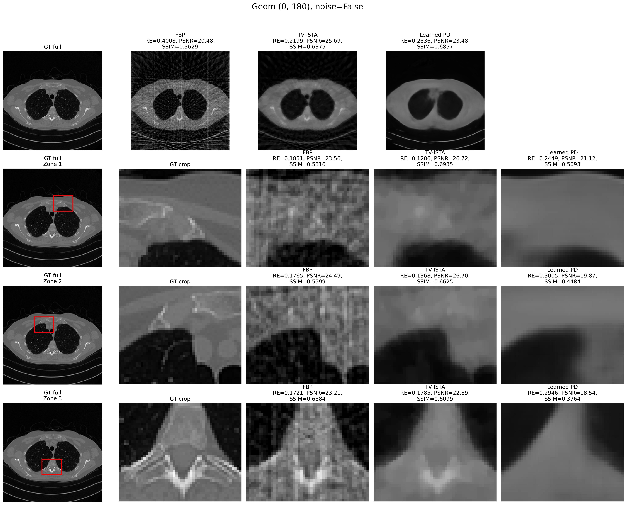











Geom (0°, 180°)
Noise = False

Slide 21
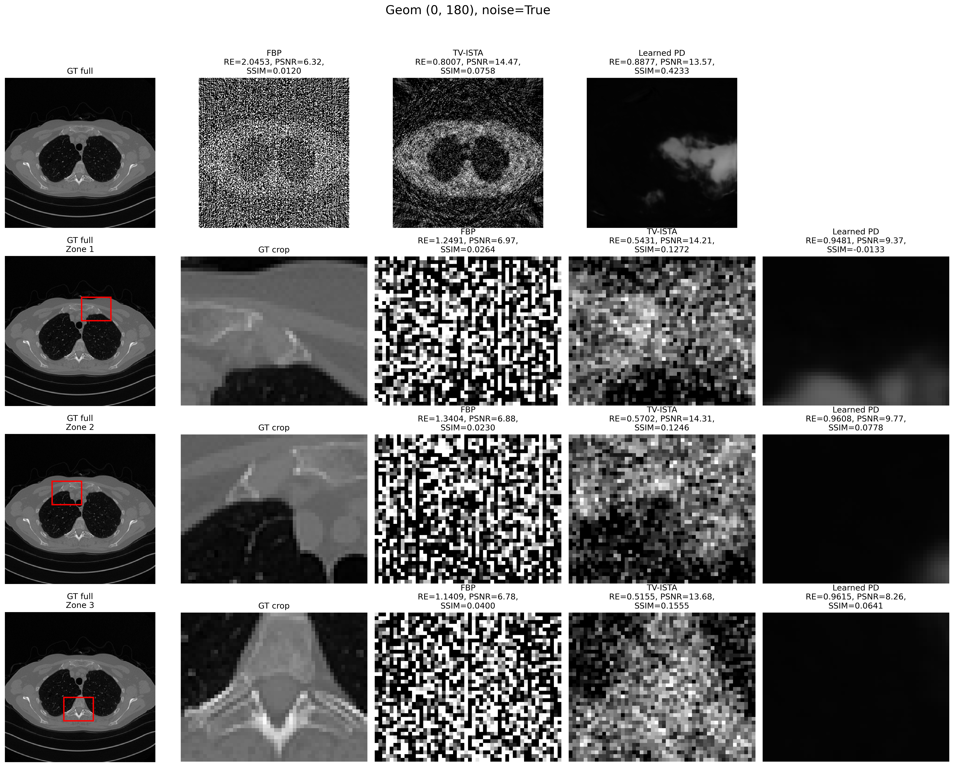












Geom (0°, 180°)
Noise = True

Slide 22
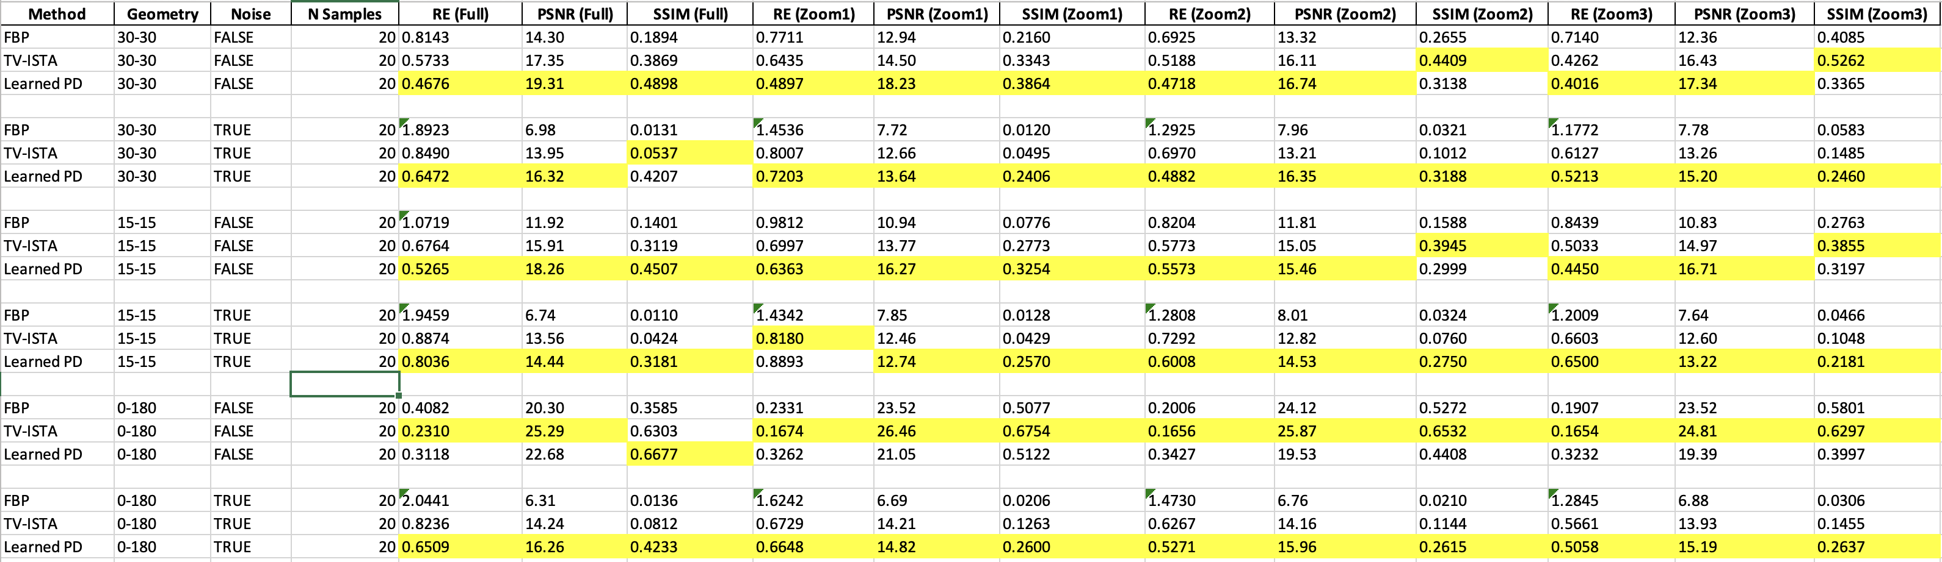
Results on a subset of the test set

Slide 23
Conclusions
FBP:
Worst performance overall
Very sensitive to noise
LPD:
Best performer for ±15°, ±30° geometries
Robust to high noise levels
Outperforms TV on noisy images in the 0°–180° range when analyzing a subset of the test set
may need longer training to fully exploit wide angular ranges (e.g., 0°–180°)
TV regularization:
Sometimes achieved higher SSIM in small regions with respect to LPD → better local detail
In 0°–180° geometry, surprisingly competed closely with LPD
Outperformed LPD in all other metrics, except SSIM on single image

Slide 24
Bibliography
J. Adler and O. Öktem, "Learned Primal-Dual Reconstruction," in IEEE Transactions on Medical Imaging, vol. 37, no. 6, pp. 1322-1332, June 2018, doi: 10.1109/TMI.2018.2799231.

Slide 25
Thank you for your attention!

